Slide 1
Linux Gateway Final Project
Enrique Saldana
Damian Cisneros

Slide 2
Goal
Main Goal
The goal of the project was to implement a WSN platform using CC1350 and Beaglebone Black (BBB).
Objectives
The objective is to send and receive sensor data from a CC1350 launchpad and use a gateway composed of a Beaglebone Black and a second CC1350 launchpad to view the sensor data.

Slide 3
Outcome - Accomplishments
Outcome – result of your project?
The light sensor is working but we were unable to integrate it into our sensor code and sent to the collector app.
The short-term usefulness of our project is that we experienced using the Beaglebone Black and establishing a WSN platform.
The long-term usefulness of our project is that we will have and idea of how to use sensor data wirelessly for future projects.

Slide 4
Components Used in Design
List Sensors, actuators, cloud or visualization sources - – give appropriate links/references
Two CC1350 launchpads, one as a sensor and the other as a co-host
Beaglebone Black (BBB)
TSL2591 Light Sensor

Slide 5
Tools used in Design
List development tools – give appropriate links/references
Code Composer Studio 8.0 http://www.ti.com/tool/CCSTUDIO
UniFlash 4.5
http://www.ti.com/tool/UNIFLASH

Slide 6
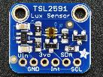
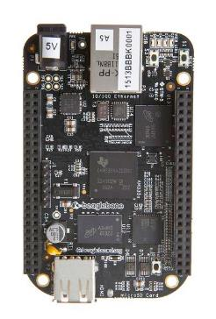
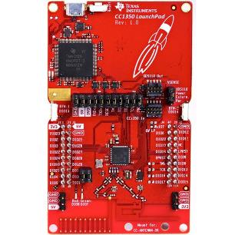

Schematics

Slide 7
Pre-requisites used in Design
Prerequisites
Install the TI 15.4-Stack Linux Gateway SDK
Prepare the embedded host
Starting the Application – Starting the Network
Commands to install prerequisites
chmod +x ti15.4stack_linux_x64_2_07_00_16.run
./ti15.4stack_linux_x64_2_07_00_16.run
rm bin/nv-simulation.bin
./run_demo.sh

Slide 8
Implementation Details
Steps used in design:
Declare header files to enable use of I2C and serial output.
Code for lux sensor is working on standalone project
Integrate to sensor.c file

Slide 9
Implementation Details
We are able to get the lux sensor working but we have issues integrating it to our sensor code.

Slide 10
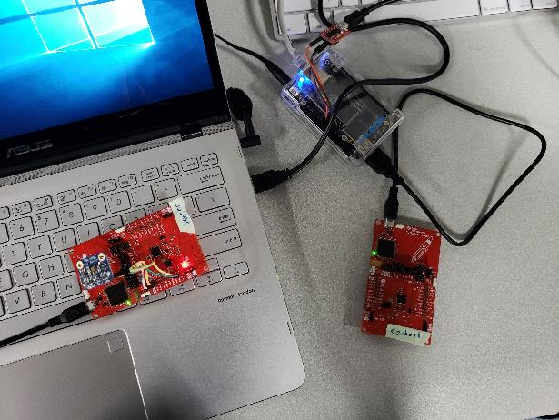
Actual project set-up

Slide 11
Demo
Video 1: Gateway Established https://youtu.be/FnT3CB-eHg4
Video 2: Light Sensor Readings https://youtu.be/mhgnIssDYTU

Slide 12
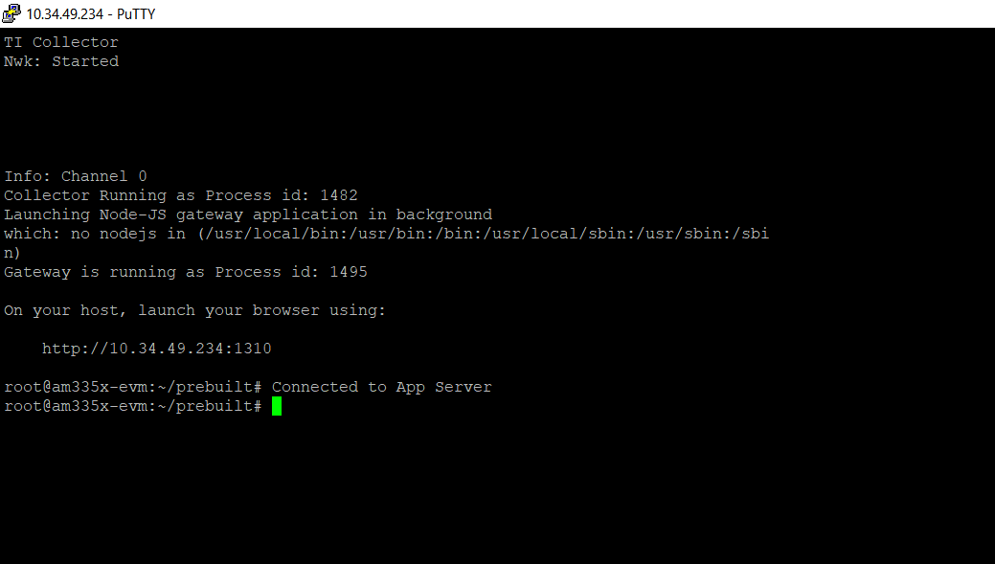
Results and Conclusions
This figure shows the app successfully starting

Slide 13
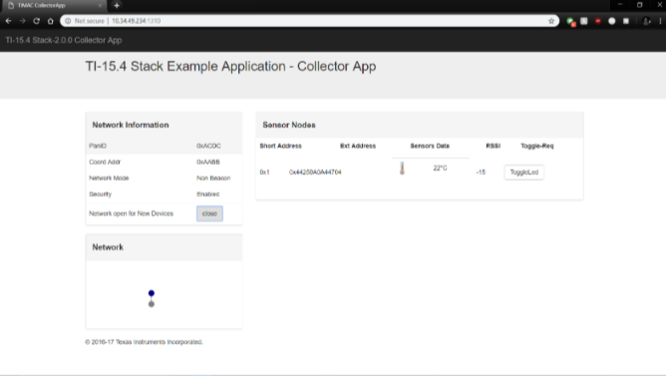
Results and Conclusions
This figure shows the temperature that was recorded from the sensor module and sent via the gateway platfrom created by the Beaglebone Black and the co-host.

Slide 14
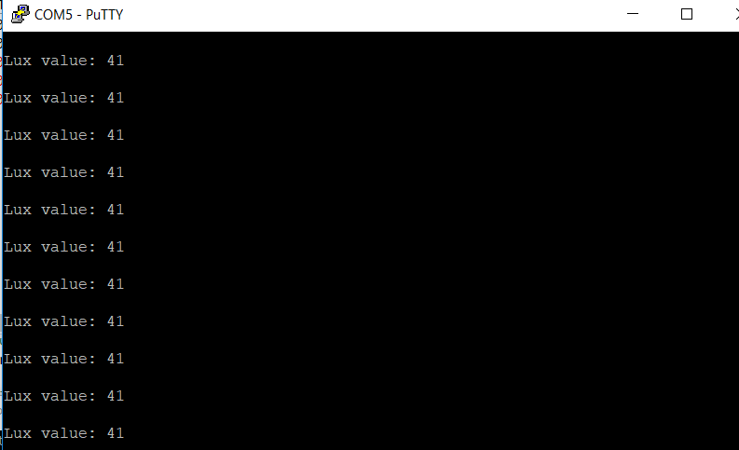
Results and Conclusions
This figure shows the lux values from the light sensor.

Slide 15
Reference
abrain. “Sub-1 GHz Sensor to Cloud IoT Gateway - Review.” Element14.Com, A Premier Farnell Company, 12 Jan. 2018, www.element14.com/community/roadTestReviews/2590/l/sub-1-ghz-sensor-to-cloud-iot-gateway-review.

